Slide 1

Lecture 6: HTML Foundations
Welcome to lecture 7!
Build your first developer profile page.

Slide 2
Today’s Agenda
Session Objectives
Complete: Semantic HTML & Forms
Review: HTML fundamentals
Introduction to CSS
Introduction to CSS
CSS Selectors (Class vs ID)
display Property: inline, block
Intro to Pseudo-classes (link, visited, hover, active)
Q&A
Homework (due next Saturday)

Slide 3
Question 1
<body>
<div>
<h1>My Course Profile</h1>
<p>I am learning full-stack development.</p>
</div>
<div>
<h2>Useful Links</h2>
<a href="https://developer.mozilla.org">MDN</a>
<a href="https://github.com">GitHub</a>
</div>
<div>
<p>Created by me.</p>
</div>
</body>
This HTML works, but the structure can be improved. Which improvement is best?
A. Replace the first div with header, wrap the links inside nav, and replace the last div with footer.
B. Replace every div with span because span is more modern.
C. Remove the h1 and use only paragraphs so the page looks simpler.
Answer: A

Slide 4
Question 2
You are creating a workshop registration form. The learner should:
enter their name
choose one preferred session time
select multiple topics they are interested in
write a short question for the instructor
Which form structure fits best
A. text input, checkboxes, radio buttons, input type="password"
B. text input, radio buttons, checkboxes, textarea
C. textarea, select, input type="email", button
Answer: B

Slide 5
Question 3
Complete the missing parts so the image, link, and form label work correctly. Which option correctly fills the blanks?
A. href, title, src, id, for
B. src, alt, href, for, id
C. src, name, href, id, for
<section>
<h2>My Profile</h2>
<img ___="profile.jpg" ___="A profile photo">
<p>
Visit my
<a ___="https://github.com">GitHub profile</a>
</p>
<form>
<label ___="learner-email">Email</label>
<input type="email" ___="learner-email" name="email">
</form>
</section>
Answer: B

Slide 6
Question 4
Both snippets create a blog preview section. Which one is better structured?
A) B)
<section>
<h2>Latest Blog Post</h2>
<article>
<h3>Why HTML Structure Matters</h3>
<p>HTML helps browsers and developers understand page content.</p>
<a href="blog.html">Read more</a>
</article>
</section>
<article>
<h2>Latest Blog Post</h2>
<section>
<h3>Why HTML Structure Matters</h3>
<p>HTML helps browsers and developers understand page content.</p>
<a href="blog.html">Read more</a>
</section>
</article>
Answer: A. Why? because the page section groups the “Latest Blog Post” area, and the individual blog preview can be treated as an article

Slide 7
Introduction to CSS

Slide 8
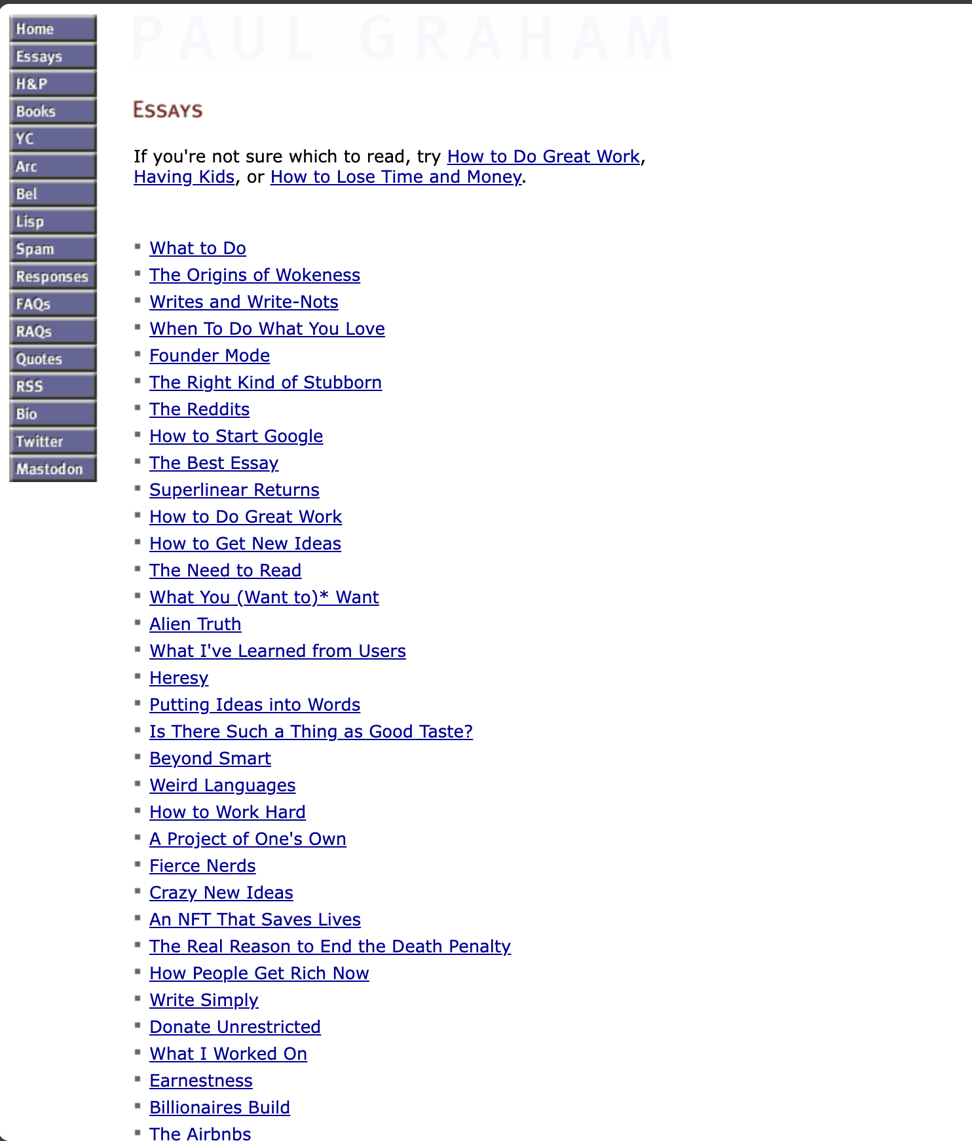
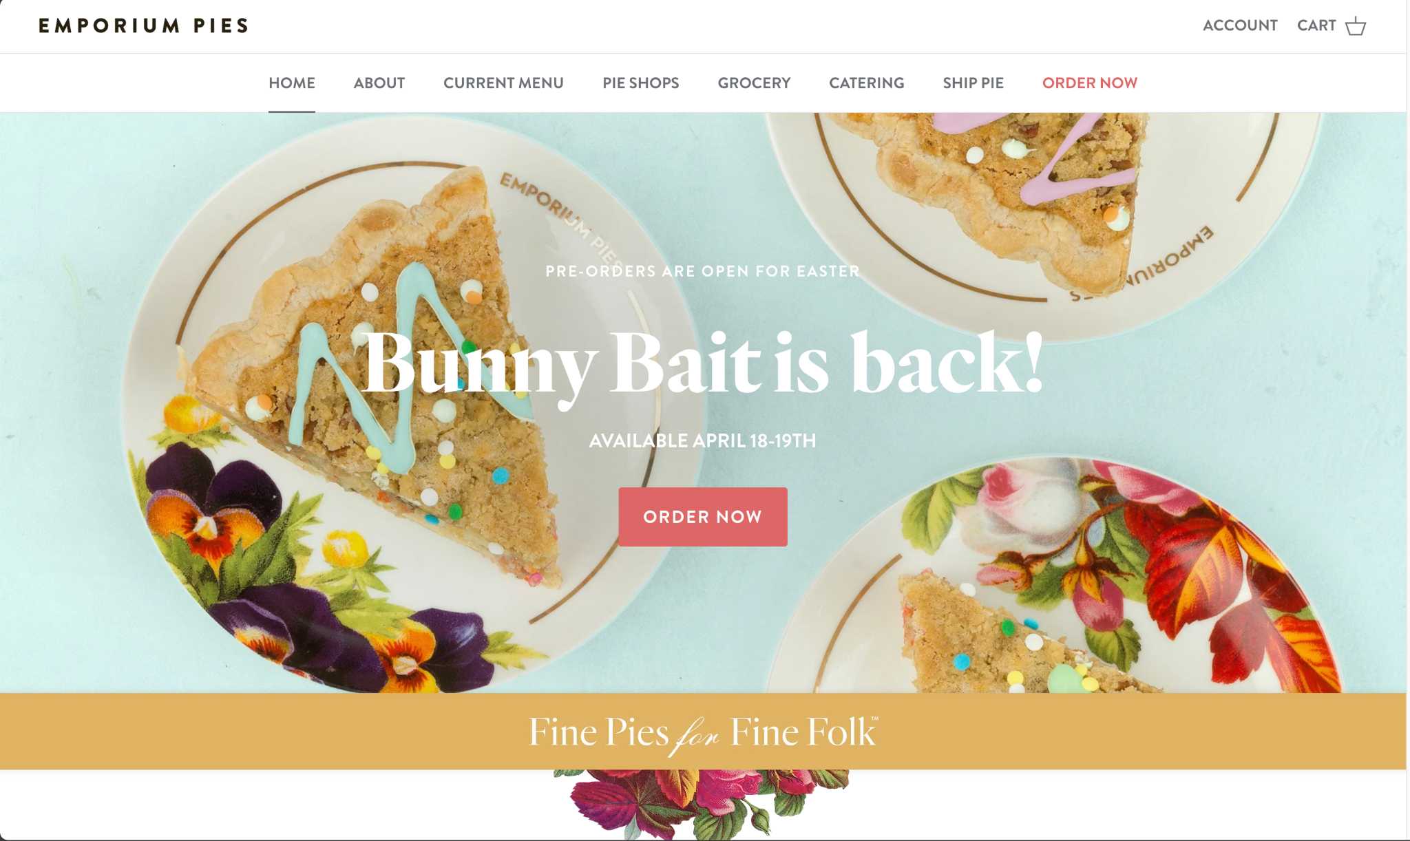
What differences do you see in the in design?
Website 1
Website 2

Slide 9
Painting a webpage with CSS!
What is CSS?
Cascading Style Sheets.
A stylesheet language used to describe the presentation of a document written in a markup language like HTML
Controls how HTML elements are displayed on screen, paper, or in other media
Defines the visual style of a webpage
Colors: change backgrounds, text, borders, and more.
Fonts: choose from a variety of fonts to enhance readability and aesthetics
Layout: control how elements are positioned and arranged on the page
Spacing: adjust margins and padding to create visual harmony
And much more: animations, transitions, responsiveness, etc.

Slide 10
Why Use CSS?
Clean Code
Separates design from HTML structure
Easy Updates
Changing the theme of a website can be done by changing the CSS files only
Consistent Look
Styles for headers, paragraphs and other elements for all HTML pages can be centrally defined
Faster Loading: smaller file sizes and browser caching
To load a website, the browser needs to fetch the HTML/CSS files from a server
Large HTML/CSS files can impact website load times
Responsiveness
From a smartphone to a smart TV, adapts to different screen sizes
Good for Everyone
Well-structured CSS helps users with disabilities navigate and understand your content more easily

Slide 11
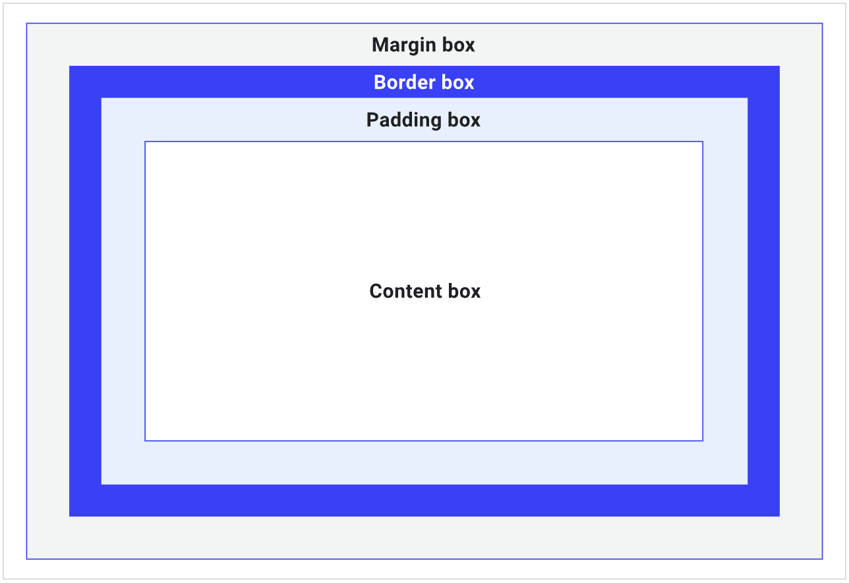
What is the CSS Box Model?
Every HTML element on a webpage is treated as a rectangular box
The CSS Box Model defines how these rectangular boxes are structured and how they interact with each other on the page
Understanding the Box Model is crucial for controlling the layout and visual appearance of your webpages

Slide 12
The Anatomy of a Box
Content
The innermost part of the box, where the actual content (text, images, etc.) resides
Padding
The space around the content, inside the element's border. It creates a visual buffer between the content and the border
Border
A line that surrounds the padding and the content. It defines the edge of the element
Margin
The space outside the border, separating the element from other elements on the page. It creates visual space between neighboring elements

Slide 13
CSS Selectors

Slide 14
CSS Selectors

Slide 15
Introduction to CSS Selectors
What are selectors?
Patterns used to select the HTML elements you want to style
They act as a bridge between your CSS rules and the HTML elements
Different types of selectors target elements with varying degrees of precision. Include:
Basic selectors: Select elements by their name, class, ID, or universally (all elements)
Combinators: Refine selections based on hierarchical or sibling relationships in the DOM
Attribute Selectors: Select elements by the presence or value (exact or partial) of their attributes
Pseudo-class Selectors: Select elements by the presence or value (exact or partial) of their attributes
Pseudo-element Selectors: Style generated content or specific parts of elements (e.g., ::before, ::first-letter)

Slide 16
Basic Selectors
What are basic selectors?
The foundation of CSS element targeting
Types of basic selectors
Element (Tag) Name: Targets all HTML elements of a specific type (e.g., p, h1).
Class: Targets elements with a specific class attribute.
ID: Targets a single, unique element with a specific id attribute
Universal Selectors: Targets all elements in an HTML page

Slide 17
Basic Selectors: Tag based selector
Targets all HTML elements of a specific type
A basic selector
Syntax: elementname (e.g., p, h1, div) { … }
Targets all HTML elements of a specific type.
Example: p { color: blue; }
Will turn all paragraph text to blue color
Index.html (internal CSS)
<!DOCTYPE html>
<html>
<head>
<style>
h1 {
color: green;
text-align: center;
}
p {
color: blue;
}
</style>
</head>
<body>
<h1>Welcome</h1>
<p>This is the first paragraph.</p>
<p>This is the second paragraph.</p>
</body>
</html>
Index.html (Linked CSS)
<!DOCTYPE html>
<html>
<head>
<link rel="stylesheet" href="styles.css">
</head>
<body>
<h1>Welcome</h1>
<p>This is the first paragraph.</p>
<p>This is the second paragraph.</p>
</body>
</html>
styles.css
h1 {
color: green;
text-align: center;
}
p {
color: blue;
}
OR

Slide 18
Class Selector
What are class selectors?
Targets HTML elements with a specific class attribute
Allows you to apply the same styles to multiple elements
Syntax:
.classname (e.g., .important, .highlight)
The classname, like variable names in Javascript, is decided by the developer
Key features
The class attribute can be added to any HTML element
Multiple classes can be applied to an element, separated by spaces.
Example: .important { font-weight: bold; }
Will make text in elements with the class "important" bold
Classes promote reusability of styles across different elements

Slide 19
Example: Class Selector
HTML Snippet from Index.html
styles.css
<div class="card">
<h2>Card Title 1</h2>
<p class="important">This is important content.</p>
</div>
<div class="card highlight">
<h2>Card Title 2</h2>
<p>Some regular content.</p>
</div>
.card {
border: 1px solid #ccc;
padding: 10px;
margin-bottom: 10px;
}
.important {
font-weight: bold;
color: red;
}
.highlight {
background-color: yellow;
}

Slide 20
ID Selector
What are ID selectors?
Targets a single, unique HTML element with a specific id attribute
Syntax:
#idname (e.g., #main-header, #submit-button)
The idname, like variable names in Javascript, will be defined by the developer
Key features
The id attribute should be unique within an HTML document
Primarily used for JavaScript interaction or very specific styling
Example: #main-header { font-size: 24px; }
The element with the ID "main-header" will have a font size of 24 pixels
ID selectors have a higher specificity than class selectors
If you have an element with id and class attribute, the styles in the id attribute generally overrides class styles

Slide 21
Examples: ID Selector
Example 2: what will be the color of the header?
Example 1
HTML Snippet from Index.html
<h2 class="section-heading" id="page-title">Page Title</h2>
HTML Snippet from Index.html
<h1 id="main-title">Welcome to Our Website</h1>
<p>Some introductory text.</p>
styles.css
styles.css
.section-heading {
color: orange;
font-size: 1.5em;
}
#page-title {
color: green;
text-align: center;
}
#main-title {
color: purple;
text-align: center;
border-bottom: 2px solid purple;
}

Slide 22
Class vs ID: Choosing the Right Selector
When to use class selector?
Use when you want to style multiple elements the same way
Reusable across different elements
Can be used multiple times on a single page
When to use ID selector?
Use when you want to style a single, unique element
Should be unique within the HTML document
Often used for specific layout elements or JavaScript targeting
Has higher specificity than class selectors
Best Practice: Generally, prefer using classes for styling and IDs for JavaScript functionality or unique layout sections

Slide 23
Basic CSS properties

Slide 24
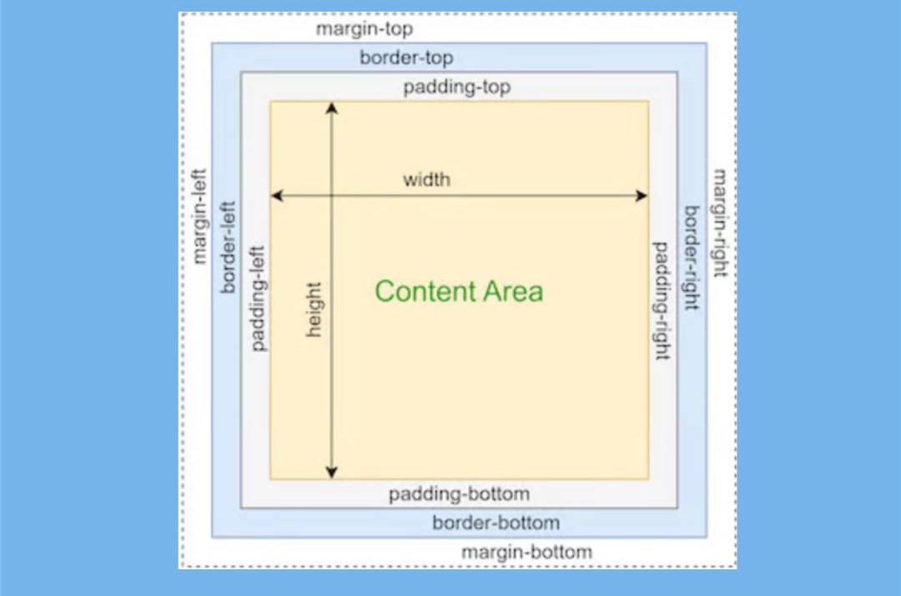
What can CSS change?
Any ideas?
Color
Font
Font-size
Font-family
Font-weight
Line-height
Alignment: Text-align
Space
Padding, Margin, Width, Height
Shape & Surface
Background-color, border, border-radius

Slide 25
Live coding! Let’s code a basic profile.

Slide 26
Controlling element display

Slide 27
Introduction to the ‘display’ property
The display property in CSS controls how an element is rendered on the page.
Dictates the flow of the element in relation to other elements
Key values for the display property that we will cover today
block
Inline
What does display: block; mean?
Block-level elements behave like a block of content
They always start on a new line
They take up the full width available in their parent container (stretching to the left and right)
By default, their height is determined by their content
The width and height properties on block-level elements can be set by the developer
Examples of block-level elements by default
<div>, <p>, <h1> to <h6>, <ul>, <ol>, <li>, <form>

Slide 28
Example: display property
HTML Snippet from Index.html
styles.css
<div style="border: 1px solid red;">First div</div>
<div style="border: 1px solid blue;">Second div</div>
<p style="border: 1px solid green;">First paragraph.</p>
<p style="border: 1px solid orange;">Second paragraph.</p>
/* You can optionally add this to explicitly set display: block */
div {
display: block;
}
p {
display: block;
}

Slide 29
Display property: Inline elements
What are inline elements?
Inline elements flow along with the surrounding content, like words in a sentence
They do not start on a new line
They only take up as much width as their content requires
You cannot set the width and height properties on inline elements directly; they are determined by the content
Examples of inline elements by default: <span>, <a>, <img>, <strong>, <em>
Example:
HTML Snippet
styles.css
<span>First span</span>
<span>Second span</span>
<a href="#">First link</a>
<a href="#">Second link</a>
span {
display: inline;
border: 1px solid purple;
}
a {
display: inline;
border: 1px solid brown;
}

Slide 30
Key Differences: inline vs block
Setting display to block
Use for structural elements and content that needs to be on its own line
Good for containers and larger blocks of text
Allows setting width and height
Setting display to inline
Use for small elements within a line of text
Good for formatting specific words or phrases
width and height properties are ignored

Slide 31
Exercise
Write down the CSS selector(s) you would use to target each of the following elements:
The main title "Awesome Gadget".
All elements with the class "price".
The "Add to Cart" button.
The entire product card
Display: How would you use the display property to make the "price" ($19.99) and the "Add to Cart" button appear on the same line, next to each other? Briefly explain which display value(s) you would use and why.
<div class="product-card">
<h2 id="product-title">Awesome Gadget</h2>
<span class="price">$19.99</span>
<p class="description">This is a brief description of the awesome gadget.</p>
<button class="add-to-cart">Add to Cart</button>
</div>

Slide 32
Introduction to Pseudo-classes

Slide 33
Styling Link States: Pseudo-classes
Style elements in different states
For links, we often style them based on whether they've been visited
Pseudo-classes are denoted by a colon(:) followed by the name of the pseudo-class (e.g., :hover, :active)
Commonly used pseudo-classes:
:link: Applies style to links that the user has not yet clicked
Allows you to set a default style for unvisited links
Example: a:link { color: blue; text-decoration: none; } (Blue, no underline)
:visited: Applies style to links that the user has already been clicked
Useful for providing feedback to the user about which links they have already clicked
Think: Links on a search results page that you've already clicked
Example: a:visited { color: purple; text-decoration: underline; } (Purple, underlined)

Slide 34
Example: Pseudo-classes
HTML Snippet
styles.css
<p><a href="https://www.google.com">Visit Google (Unvisited)</a></p>
<p><a href="https://www.example.com">Visit Example (Might be visited)</a></p>
a:link {
color: blue;
text-decoration: none;
}
a:visited {
color: purple;
text-decoration: underline;
}

Slide 35
Pseudo-classes: hover
The :hover pseudo-class applies styles when the user moves their mouse pointer over an element.
Commonly used to provide interactive feedback, such as changing the appearance of buttons or links.
Example
a:hover { color: red; }
Turn the color of the link text red when the mouse is over it
HTML Snippet
styles.css
<p><a href="https://www.google.com">Visit Google (Unvisited)</a></p>
<p><a href="https://www.example.com">Visit Example (Might be visited)</a></p>
a:hover {
color: red;
font-weight: bold;
}

Slide 36
Pseudo-classes: active
Styles an element at the moment it is being clicked. Eg: when the mouse button is pressed down
Provides immediate visual feedback to the user that their action is being registered
The effect is usually very brief, lasting only while the mouse button is held down
Example
a:active { background-color: yellow; color: black; }
Yellow background, black text while clicking
HTML Snippet
styles.css
<p><a href="https://www.google.com">Visit Google (Unvisited)</a></p>
<p><a href="https://www.example.com">Visit Example (Might be visited)</a></p>
a:active {
background-color: yellow;
}

Slide 37
Order of Pseudo-classes
When styling links, it's important to define the pseudo-classes in a specific order for them to work correctly
The recommended order is (acronym LVHA):
:link
:visited
:hover
:active
If these are not in the correct order, some styles might not be applied as expected (e.g., :hover might override :visited)

Slide 38
Homework

Slide 39
That’s it for today!
Any questions?

